Slide 1
Watch Dog 5
Overview
Anti – Fraud system

Slide 2
Agenda
Fraud Overview
Solucion ICE
Architectura del sistema
Hardware & Software
Flujo de datos
Rating Rules
GUI
Rutinas de mantenimiento

Slide 3
Agenda
Fraud Overview

Slide 4

FRAUDE Y DETECCIÓN
Definición de fraude
Fraude es siempre cometido por
Es el uso o adquisición de los servicios de telecomunicaciones a través de medios ilegales y sin la intención de pagar por ellos
¡gente!
¿Porqué?
“Negocios” legítimos
Venganza
Desafío - respeto
Evasión de vigilancia
Evitando restricciones de tráfico
Empresarios ofreciendo “servicios sociales” a los pobres

Slide 5
Aspectos relevantes del Fraude en las Telecomunicaciones
Según CFCA (Communications Fraud Control Association) y estudio realizado entre diferentes operadoras se considera que anualmente las pérdidas por Fraude en Las Telecomunicaciones ascienden entre $35 a $40 Billones (U.S Dólar).
80% de las compañías de Telecomunicaciones indican que el fraude continúa en ascenso.
45% de las compañías de Telecomunicaciones indican que el Fraude se ha incrementado dentro de su propia compañía.
Fraude a través de tráfico internacional (By-pass) están siendo muy relevantes.
El fraude evoluciona con la tecnología y su entorno.

Slide 6
Identificando al enemigo?
Quién es el enemigo de las Compañías de Telecomunicaciones?.
Tres importantes grupos Fraudulentos:
1.- Quienes ejecutan fraude por diversión.
2.- Quienes ejecutan fraude para “ahorrar” dinero.
3.- Quienes ejecutan fraude para obtener ingresos.
Nota: Las pérdidas por Fraude en Telecomunicaciones representan entre 2% y 5% de los Ingresos de las empresas del sector

Slide 7
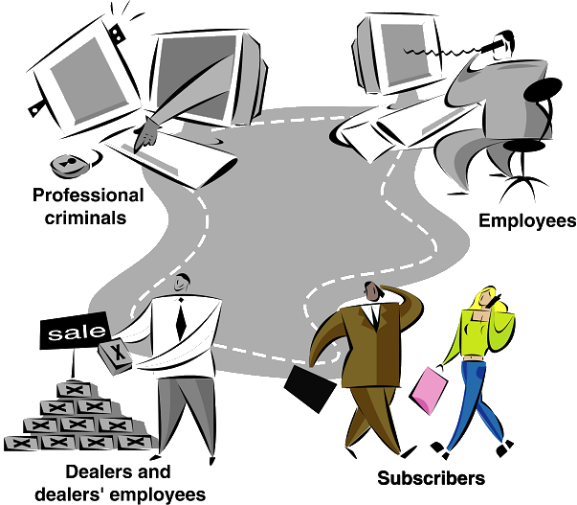
FRAUDE Y DETECCIÓN
¿Quién son los estafadores?
Criminales
profesionales
- Empleados
- Comerciantes y
empleados
- Abonados

Slide 8
ALCANCE DE SISTEMA DE
DETECCIÓN DE FRAUDE
Detección automática de fraude potencial
(en vez de buscar manualmente)
Posibilidad de entrada múltiple de variables
Colección de información en el
“case manager”
Capacidad de manejar gran cantidad
de trafico
Complemento de análisis humano – da
buena fundación por decisiones
Analisis de trafico basado en CDRs

Slide 9
Tipos de alarmas
Subscription fraud
Cloning
Tumbling
Roaming fraud
Internal fraud
Prepaid fraud
Black list
Hot list
Theft
SIM box fraud
Credit Limit
Hacking
Call back
Short duration
Extended services
High risk countries
High usage

Slide 10
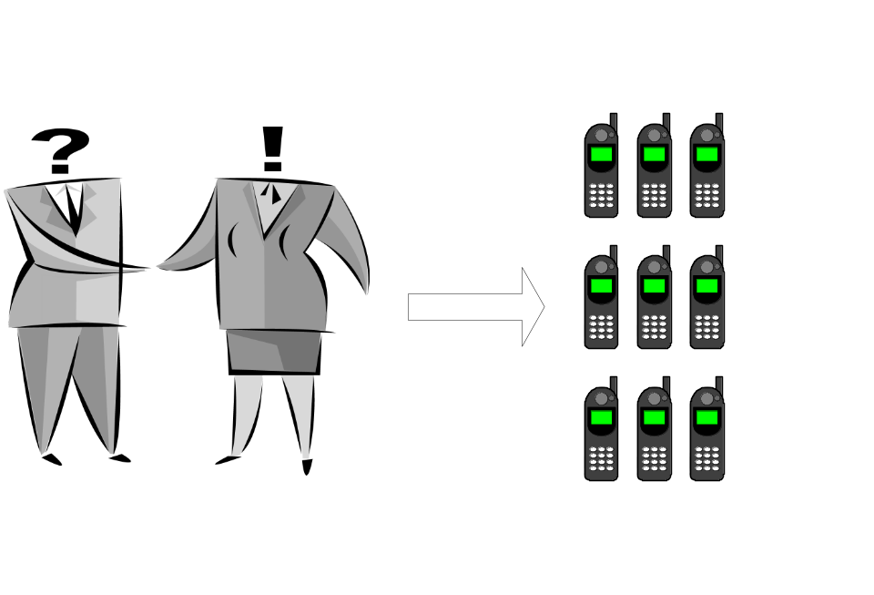

Flujo Watchdog:
Casos de fraude de suscripción
Fraude de suscripción: Obtener suscripciones reales sin intención de pagar.
Dear Dealer!
I am a very nice
person working for
Basset. I would like to
have five of your
nicest phones and
five subcriptions.
Please, send the
invoice to Basset.
Kind regards,
Rob Ripoffsky
Dan Jackiells
12/04/72
Notes:
Subscription fraud means that people obtain real subscriptions but still have no intention of paying for the phone calls or the used services. The subscriptions are obtained e.g. by using false identification documents.
On today’s competitive market, customers demand services such as instant access to the network when signing subscriptions. This allows no time for the resellers to fully establish the identity of new subscribers. Resellers might not even have any interest in making thorough identity checks. This means more work, and maybe less commission, but there is nothing to gain. Subscriptions can also be approved without face-to-face interaction. New services, such as Internet access, have made individual subscriptions more valuable than when only voice was avail­able. Reasons like this have made subscription fraud very common.
How is subscription fraud performed?
Subscription fraud can be performed in different ways. Below are some examples.
By using ones own identity
By using false, or other people’s, identities
By making use of technical errors in the network (switch malfunctions, billing malfunctions, etc.)
The following sections describe different types of subscription fraud in more detail.
Using false personal information
A fraudster may try to obtain a subscription by providing false information when signing the subscription. Identifying these persons while they are applying for a subscription may be difficult. The identification problems are also different around the world. In countries where automation (computerisation) has not yet been developed for online verification of IDs, it is very hard to identify almost anything. Information that should be verified is e.g. name, address, and credit records.
Below are some examples of how false personal information can be used when applying for a subscription.
The subscriber uses a safe drop address when applying for a subscription. This is known as “empty house fraud” – the subscriber does not live on the address given to the operator.
Impersonation fraud is when fraudsters assume the identities of legitimate persons.
Material falsehoods are told at the time of application, e.g. false employer details, contact numbers, salary, etc.
Using correct personal information
Some of the fraudsters are using their own identity documents. This makes it possible for the telecom operator to start legal actions as soon as the bills are not paid. But, very often the fraudster is changing some of his personal information on the subscriber form to make it difficult, or impossible, to find the subscriber after the fraud is committed.
Some common changes of personal information are:
The name is misspelled
An extra (middle-) name is added
The subscriber's first and second name have changed places
The street name is misspelled
The street doesn't exist
The street number doesn't exist
P.O. box is used
Information is missing on the application form
Unknown alien ID
Many of these fraud cases are possible to perform due to deficiencies in the computer systems (front-end systems) that are used to handle cus­tomer information, e.g. the billing system. Another reason might be in­sufficient, if any, control during subscription signing.
Operators should also have in mind that subscribers sometimes give fully correct information, but still have no intention to pay for the used services.
Using another person’s personal information
Usage of other people’s identities is one of the most common ways to commit subscription fraud. This is often referred to as “identity cloning”. With the use of computers, scanners, and colour printers, false identification documents are easily produced and at the same time very difficult to spot. It is extremely important that the staff are trained to spot fraudulent documents. Very small changes, such as changed spelling of the name, changed control number, etc. may result in impossibility to send the bill to the correct person.
Identity cloning can be avoided by carrying out credit checks, sharing information about fraudulent attempts with other lenders, and by check-ing identification documents. A recommendation is to get copies of false identification cards from the police and/or customs. In this way the staff will learn to identify them.
It has been described earlier that it is the reseller, or similar, who has to verify that the person signing the con­tract is the same as on the identification document. It is therefore important to make sure that their staff are educated in the matter, and practice appropriate authentication policies.
Using a legitimate company's name
The use of company logos, names, letter headed papers and purchase orders, or VAT numbers, may make it possible for a fraudster to obtain subscriptions without being employed by the company that is used. If the fraudster also is neatly dressed, the impression he makes will be even more trust-worthy.
This kind of application fraud often takes quite a long time to discover. If excessive airtime usage takes place, accounts may still not be immediately barred since the credit limit set may reflect the “real” company’s true credit rating.
Using a non-existing company's name
Fraudulent use of non-existing company names, logos, or headed papers and purchase orders, could lead to the same consequences as described in the previous section. It is therefore important that sufficient authentication and credit checks take place.
If the fraudster succeeds to get the subscription, it is often difficult for the operator to detect the fraudulent use until they bill the customer. Dealers do not always inform the telecom operator if they experience that a customer is fraudulent after a subscription has been signed.

Slide 11
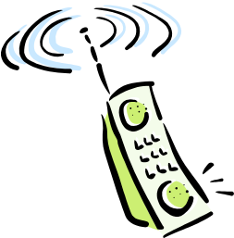
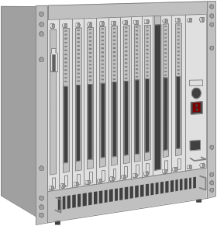


Flujo Watchdog:
Casos de fraude de suscripción
Errores de sistema/ acontecimientos no previstos
“111”
“00933123456”
“111”
“111”
“111”
Sistema Billing

Slide 12

Flujo Watchdog:
Casos de fraude de suscripción
070710*1190
0707101190
070710*1190
“Error!”
Invoice
Billing system

Slide 13
Flujo Watchdog:
Fraude de suscripción – tipos de alarmas
High usage – Uso elevado
High usage to high-risk countries – Uso elevado a países de riesgo alto
High usage from high-risk cell sites – Uso elevado en sitios celulares de riesgo alto
Long duration calls – Llamadas a larga duración
Short duration calls – Llamadas a
Zero usage
Extended services alarm
Global fraud
Same called number
Known pattern profiling
Used services

Slide 14
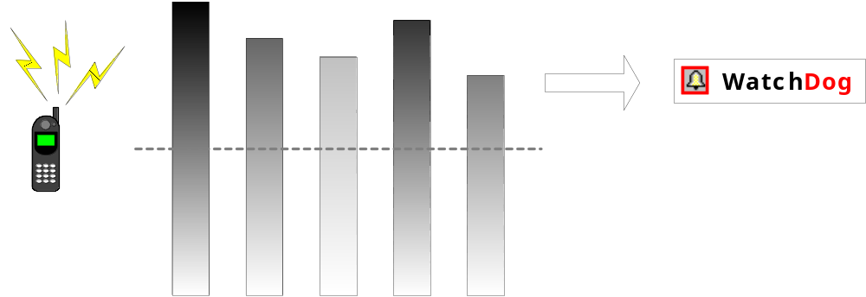
Flujo Watchdog:
Fraude de suscripción – tipos de alarmas
Uso elevado
Uso elevado: Abonado hace llamadas en exceso de la cantidad del umbral
Parámetros del umbral de uso elevado
Tipo llamada: flexible, p.ej. urbana, interurbana, internacional, premium rate, roaming, todo
Periodos: flexible, p.ej. corto, medio, largo
Base de unidades: valor monetario, duración, cantidad de llamadas, porcentaje de valor monetario total
Cualquier CDR o valor de abonado en Watchdog.
Notes:
The subscription fraud alarms are intended to detect subscribers that e.g. sell calls, or that simply are using their subscriptions with no intention of paying for the services. This kind of activities often result in high usage, or other kinds of abnormal calling behaviours.
1 High usage. WatchDog can be set to generate alarms based on quantitative thresholds. The thresholds can be set for different types of calls and for different time periods, based on different quantitative units. These options can also be combined according to each operator’s requirements.
The alarm thresholds can be set using the following call types.
Local calls. This threshold applies to local calls made within the network.
Long distance calls. This threshold applies to long distance calls made within the network.
International calls. This threshold applies to international calls.
Premium rate calls. This threshold applies to calls made to premium rate numbers.
Roaming calls. This threshold applies to calls made by the operator’s subscribers in other networks. The alarms are based on data from roaming files.
All calls. This threshold applies to all call types summarized.
The number of time periods is flexible, and so is the duration of each period. A typical setup can look like below.
Short. The typical short time period is 8 hours or shorter.
Medium. The typical medium time period is 24 hours.
Long. The typical long time period is 7-14 days.
The high usage alarm can be based on the following quantitative units.
Monetary value. An alarm will be generated if the total value of the calls exceeds a monetary limit within any of the time periods.
Duration. An alarm will be generated if the total duration of the calls exceeds a limit in terms of duration within any of the time periods.
Number of calls. An alarm will be generated if the number of calls exceeds this limit within any of the time periods.
Percentage of total monetary value. An alarm will be generated if the quantity of a certain call type, relative to the total usage, exceeds this limit.

Slide 15
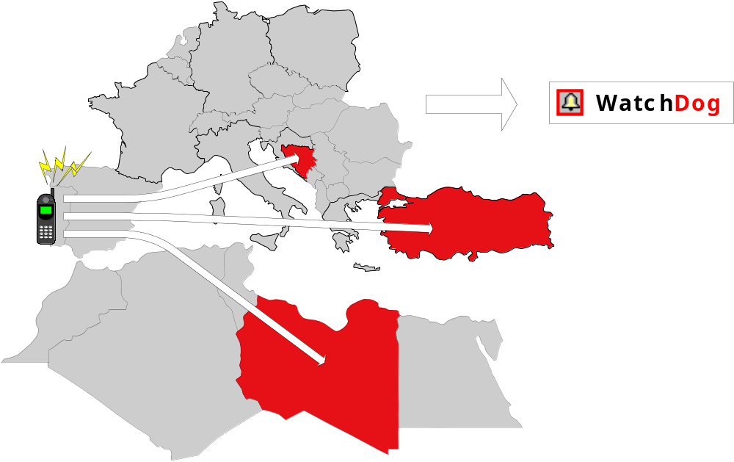
Flujo Watchdog:
Fraude de suscripción – tipos de alarmas
Países de riesgo alto: Alarma cuando abonados hacen llamadas a países conocidos por actividades de fraude
Países de riesgo alto
Notes:
1 High usage to high-risk countries. Any country can be classified as a high-risk country, and for each of these a specific high usage threshold can be set. The purpose is to have immediate alerts for subscribers calling to countries known for frequent fraudulent activities.
2 High usage from high-risk cell sites. Any cell-site can be classified as a high-risk cell site, and for each of these cell sites a different high usage threshold can be set. The purpose is to have immediate alerts for subscribers calling from locations known as fraudulent.

Slide 16
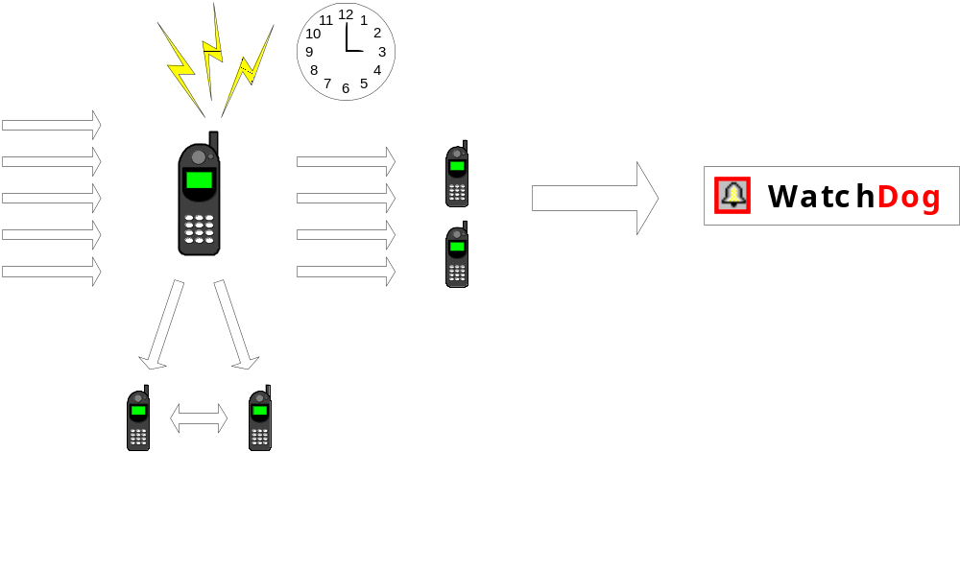
Flujo Watchdog:
Fraude de suscripción – tipos de alarmas
Servicios extendidos
Servicios Extendidos: Uso elevado de call forwarding, call waiting, y three party calls
Notes:
This alarm is triggered by high usage of extended services, such as call forwarding, call waiting, and three party calls. The purpose is to detect call selling and subscription fraud.
The illustration shows that an alarm is generated if a phone is forwarding all calls or making three party calls during a period of time.

Slide 17
Flujo Watchdog:
Fraude de suscripción – tipos de alarmas
Servicios Extendidos
Lllamadas “Three party”
Servicios Extendidos: Uso elevado de call forwarding, call waiting, y three party calls

Slide 18
Flujo Watchdog:
Fraude de suscripción – tipos de alarmas
Servicios Extendidos
Call Forwarding
Servicios Extendidos: Uso elevado de call forwarding, call waiting, y three party calls

Slide 19

Flujo Watchdog:
Caso de clonación
Medida 1
Leer información original SIM
Clonación: Facilitar llamadas usando suscripción de otra persona
Medida 2
Proceso de decodificación
Medida 3
Escribir información clonada
y decodificada
Medida 4
¡SIM Clonado! Listo a usar
Notes:
The purpose of cloning is to facilitate calls where another person’s subscription is used. The benefit of cloning is that calls that are made from a cloned phone will be charged to the person having the original subscription.
Cloning differs a bit between analogue and GSM networks. The problem has also mainly been considered as related to analogue networks. How­ever, cloning is now a reality also within GSM.
Cloning in analogue networks
Subscriptions in analogue networks are usually identified by the phone number. The phone number is then programmed into each handset. This identity is called the MIN, the Mobile Identity Number. The handset itself is identified by the ESN, the Equipment Serial Number, which also is programmed into the handset. The ESN must be registered in the network’s switches in order to enable the subscriber to make calls.
Cloning of an analogue phone means that a valid ESN/MIN combination is copied to another handset. The information can be obtained by scanning the air during transmission, or simply from databases within telecom operations. There have also been actual fraud cases where the fraudsters got hold of the information simply by reading on handset packages which had the information printed on the outside!
Cloning in GSM networks
Cloning of GSM phones has been considered as a very complicated operation. Each subscriber is identified by the IMSI number, the Inter­national Mobile Subscriber Identity. The IMSI is stored on the SIM card. The SIM card also holds a secret key that is required when authenti­cating the subscriber in the network. To further enhance security, the authentication process involves encryption of the information. The hand­set is identified by the IMEI, the International Mobile Equipment Identity, which is programmed into the handset.
Cloning of a GSM phone means that a copy of the SIM card is made. What makes this complicated is that the fraudster needs both the IMSI and the encryption key. There is no use scanning the air for it since the encryption key is never transmitted. The required information may be obtained from the operator’s network (internal fraud) or from the SIM supplier (supplier fraud), but to read it from the SIM card, the encryption algorithm has to be cracked. However, now it can be done, by using off-the-shelf equipment.
Cloning of SIM cards, as it is known to be performed today, requires the actual SIM card that should be copied. A smart-card reader, directed by a computer, is used to read the information on it. By querying the SIM card numerous times, the required information will eventually by re­vealed, and it can be copied to an empty SIM card.
A subscriber who has had his subscription cloned, will eventually con­tact the operator when an overcharged invoice has been sent out. Other subscribers will be contacted by the operator as a result of efficient fraud detection work. When the subscriber contacts the operator, the operator will investigate call patterns and the fraudulent calls are re­moved from the customer’s bill. If the cloned subscription belongs to a company, where the bill is sent directly to the financial department, there may be a risk that the bill will be paid without noticing the extra calls.

Slide 20
Flujo Watchdog :
Tipos de alarmas - Clonación
Call collision – Colisión de llamadas
International call collision – Colisión de llamadas internacionales
Velocity – Velocidad
International velocity – Velocidad internacional
Cloning profiling – Perfil de clonado
Notes:
WatchDog detects cloning by using the following alarms.
1 Call collision. This alarm is generated if a subscriber appears to make two calls at the same time. The purpose is to detect cloning. The settings include parameters used to avoid false alarms.
2 International call collision. This alarm has the same purpose as the previous alarm. However, this alarm uses roaming data to cover also roaming calls.
3 Velocity. WatchDog analyses the moving pattern of each subscriber to detect cloning without having a call collision. A subscriber with an abnormally high speed required for traveling between two originating spots (cell sites) will generate an alarm. The speed is flexible and can be changed by the system administrator at any time.
4 International velocity. This alarm has the same purpose as the previous alarm. However, this alarm uses roaming data to cover also roaming calls.
Cloning profiling. A subscriber’s calling patterns during two different time periods are matched against each. A pattern change is an indication of cloning.

Slide 21
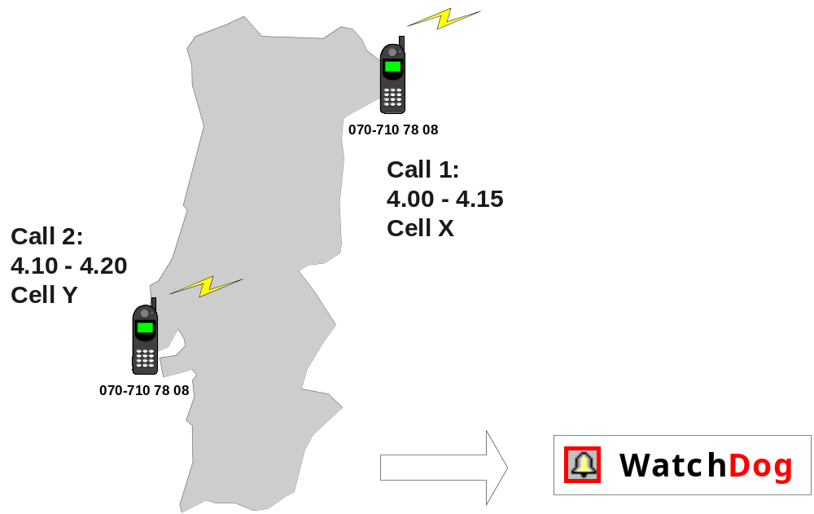
Flujo Watchdog :
Tipos de alarmas - Clonación
Colisión de llamadas
Colisión de llamadas: El abonado parece hacer dos llamadas a lo mismo tiempo
Notes:
A cloned phone that isn’t used more than normal is hard to find without appropriate tools. Finally the customer having the original subscription will notice calls on his bill that he hasn’t made. A fraud detection system, however, can detect cloning in a number of ways.
The fraud detection system can look for call collisions. One call must be ended before the next one is made. If two calls from the same subscription overlap each other, i.e. are going on at the same time, it’s a very strong indication of cloning. In connection to this it should be mentioned that the fraud detection system has to be able to ignore call types as three party calls and call forwarding. These calls generates actual call collision cases, but of a kind that is completely normal.

Slide 22

Flujo Watchdog :
Tipos de alarmas - Clonación
Velocidad
Velocidad: Hay que viajar en velocidad anormal para poder hacer llamadas de los dos lugares
De Miranda do Douro a Lisboa
hay 516 km. Viaje normal en
5 horas. 15 minutos = 2064 km/h
Notes:
A cloned phone that isn’t used more than normal is hard to find without appropriate tools. Finally the customer having the original subscription will notice calls on his bill that he hasn’t made. A fraud detection system, however, can detect cloning in a number of ways.
The fraud detection system can look for call collisions. Still it is not unlikely that a call collision will not occur, or it may take quite some time before it occurs, so the fraud detection system needs additional tools to detect cloning.
A call detail record usually includes information about the cell where a call originated. This makes it possible to measure the distance between the respective cell positions for two calls. When this distance is taken into consideration, cloning can be detected still if no call collision is present. If the time span between the calls indicates an abnormal required travelling speed between the two locations, also this is an indication of cloning.

Slide 23

Flujo Watchdog :
Tipos de alarmas – Fraude de Roaming
Área de Servicio
Operador A
(Teléfono robado)
Suscripción obtenida fraudulentamente del operador A
Representantes, interno, fraude técnico
Área de Servicio
Operador B
Suscripción usada en actividades de valor elevado
Venta de llamadas, domestico o internacional
Dirección de llamadas a números de tarificación adicional (Premium rate)
Transporte de teléfono del operador A a B
Operador B tarda en notificación a operador A
“HUR”, 24 horas o más

Slide 24
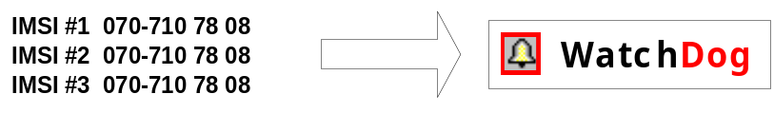
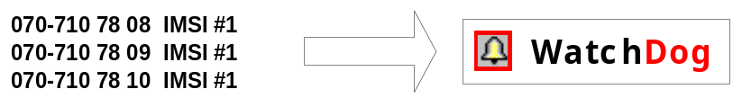
Flujo Watchdog:
Tipos de alarmas – “Tumbling”
Tumbling: El IMSI o/y el IMEI cambia entre las llamadas.
Tumbling Handsets
Mismo SIM usado en varios teléfonos
Indicaciones de venta de terminales robados
Tumbling Subscription
Uso de SIM múltiples en el mismo teléfono
Por evitar descubrimiento de SIM clonados
Estar bajo el umbral de uso elevado del operador
Notes:
Tumbling is a known method for facilitating free calls in analogue networks. Tumbling means that the ESN, and/or the MIN, are changed before each call. Please refer to the section about cloning for more information about the concept of ESN and MIN.
“Magic phones” is an expression sometimes mentioned in relation to the subject of tumbling. Magic phones are handsets that have been provided with a list of valid ESN/MIN combinations and a program that automatically changes the combination between each call.
So what is the use of tumbling?
In some roaming environments, the roaming partners have limited resources for verification of subscribers. Subscribers can then be allowed to make one call while the ESN/MIN combination is being validated. If a fraudster uses a valid MIN, the ESN can be changed for every call. The roaming partner will then treat each call as if it was the first made from a subscription.
Note that this can just as well be done in the home network. What is required is that the fraudster uses a MIN within the series for a roaming partner. The home net will then treat the calls as made from a roaming subscriber.
Another consequence of tumbling is that different subscribers are charged for each call. This reduces the risk for the fraudulent activities to be reported, since the subscriber might not notice the extra calls. Tumbling also makes it harder for an operator to trace the fraudster.
There are no obvious reasons to facilitate tumbling in GSM networks. Still it is a relevant phenomenon when it comes to finding fraud. Tumbling in GSM networks means that different SIM cards are used in the same handset, or vice versa. This can be normal, but when it happens to a large extent, it can be an indication of fraud.

Slide 25
Watchdog Workflow:
Alarm type - Internal Fraud
Switch / Conmutador
Sistema billing

Slide 26
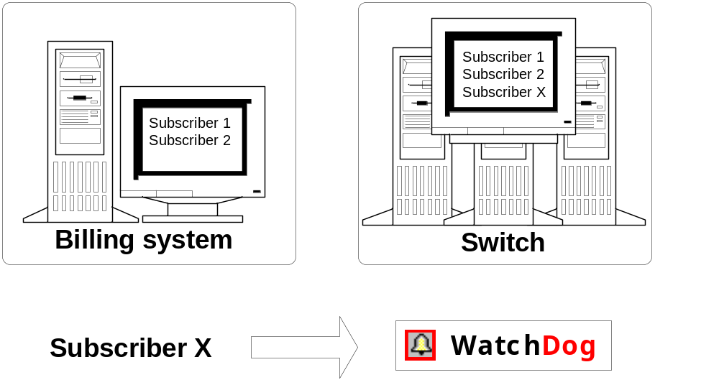
Flujo Watchdog:
Tipo de alarma – Fraude Interno
Auditoría Switch
Discrepancias entre la configuración del switch y la información en el sistema billing

Slide 27
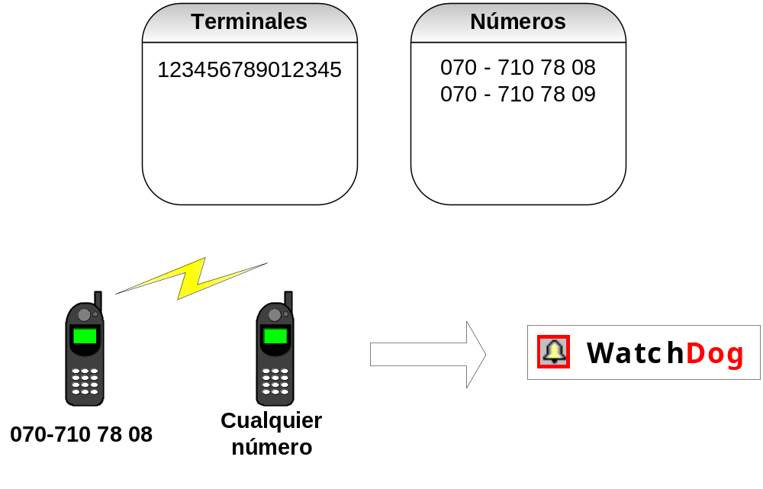
Flujo Watchdog:
Black list – Lista negra
Monitoriza comportamiento de ciertos abonados

Slide 28
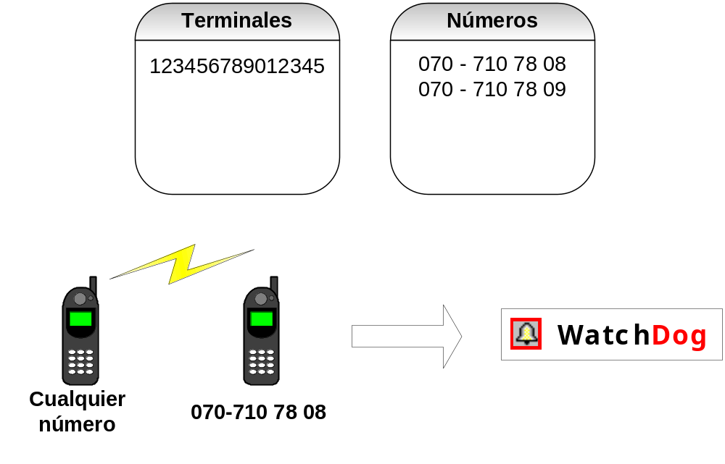
Flujo Watchdog:
Hot list – Lista Caliente
Monitoriza quien llama a
un cierto abonado

Slide 29
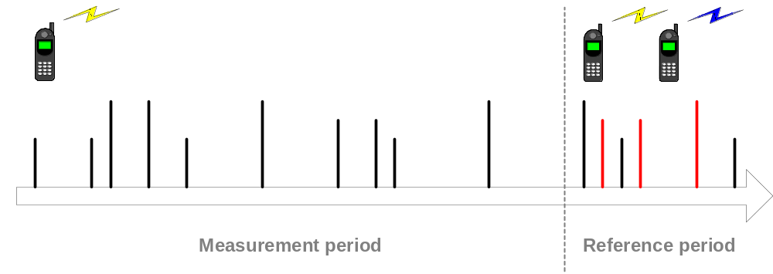
Extended profiling
Extended profiling: The calling pattern is matched to a reference period
Notes:
Check profiling period
Reference profiling period

Slide 30
Agenda
Solucion ICE

Slide 31



De que nodos se toma la información?
GSM/(E)GPRS/UMTS
SMSC
VLR
MSC
VLR
GMSC
PSTN
BSC
MSC
SS7
Prepaid
HLR
AUC
Billing
EIR
RNC
Internet
RNC
SGSN
GGSN
”3G”

Slide 32
WatchDog – Collection flow
SMS-C
Collection
Processing
WatchDog 5.0
MSC

Slide 33
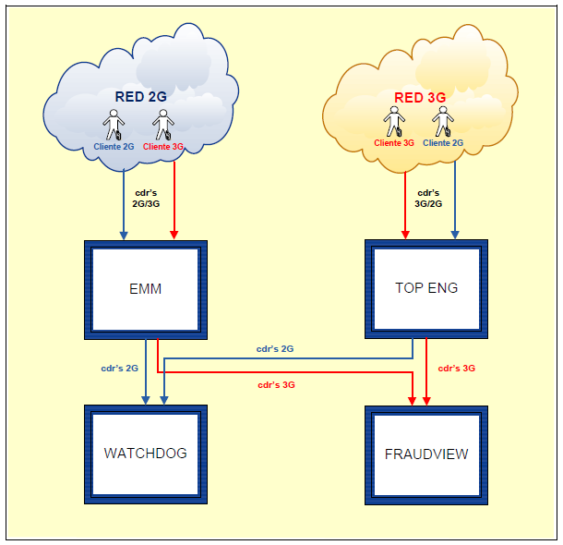
Integration between 2G/3G

Slide 34
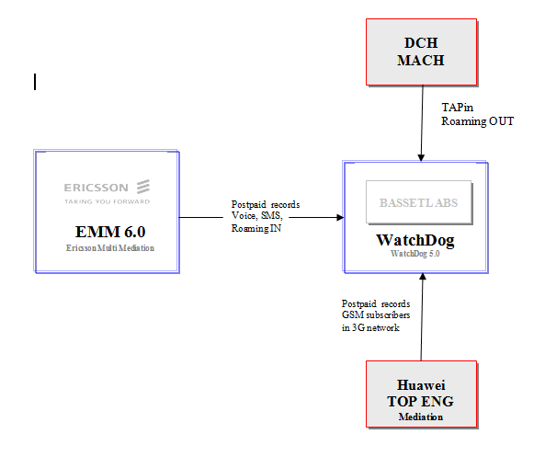
WatchDog 5 – Input files

Slide 35
Agenda
Architectura del sistema

Slide 36
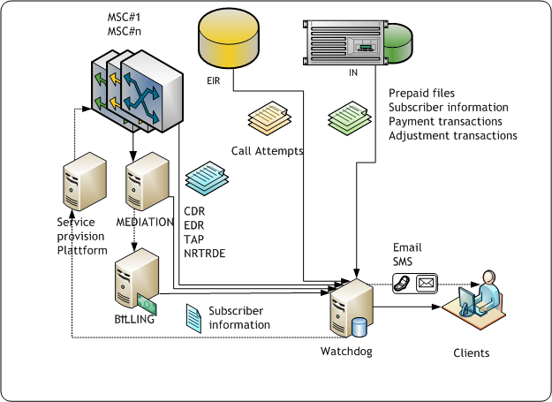
VISIÓN GENERAL DE WATCHDOG

Slide 37
Agenda
Hardware & Software

Slide 38
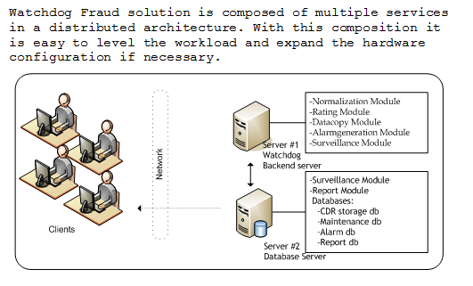
Hardware Overview

Slide 39
Hardware configuration
Backend Server
HP ProLiant DL380 G6
  2 CPUs Intel® Xeon® Processor X5560
    (8M Cache, 2.80 GHz, 6.40 GT/s Intel® QPI, x64-based PC)
  16.0 GB de memoria RAM.
  5 Discos duros de 500GB en configuración RAID 5.
    Espacio disponible en partición C: 59.9GB
    Espacio disponible en partición D: 9.99GB
    Espacio disponible en partición E: 1.75TB

Slide 40
Hardware configuration
Database Server
HP ProLiant DL380 G6
  2 CPUs Intel® Xeon® Processor X5560
    (8M Cache, 2.80 GHz, 6.40 GT/s Intel® QPI, x64-based PC)
  16.0 GB de memoria RAM.
  8 Discos duros de 500GB.
    Partición C, D: 2 Discos en RAID 1+0
    Partición E, F, G, H, I, J, K, L: 3 Discos en RAID 5
    Particion M : 3 Discos en RAID 5

Slide 41
DB Server - Partition description
Disk 1 & Disk2 in Raid 1+0 (500GB usable Disk space)
Partition C:/ (100GB) -> OS, page file, SQL Server, Master DB (.mdf and .ldf)
Partition D:/ (400GB) -> Basset applications and Watchdog DB backup.
Disk3 & Disk4 & Disk5 in Raid 5 (~931GB usable Disk space)
Partition E:/ (200GB) -> Basset data files
Partition F:/ (150GB) -> Temp DB Data (.mdf)
Partition G:/ (150GB) -> Temp DB Log (.ldf)
Partition H:/ (300GB) -> Watchdog DB Data (.mdf)
Partition I:/ (50GB) -> Subscriber DB Data (.mdf)
Partition J:/ (50GB) -> Subscriber DB Log (.ldf)
Partition K:/ (50GB) -> Reporting Services DB Data (.mdf)
Partition L:/ (50GB) -> Reporting Services DB Log (.ldf)
Disk6 & Disk7 & Disk8 in Raid 5 (~931GB usable Disk space)
Partition M:/ (931GB) -> Watchdog DB Data (.mdf)

Slide 42
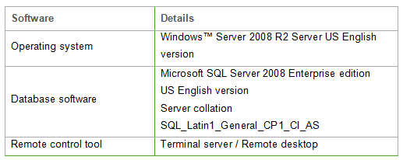
Mandatory software

Slide 43
Agenda
Flujo de datos

Slide 44


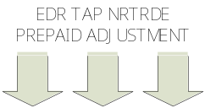
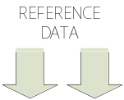


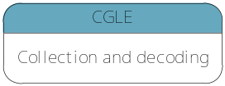
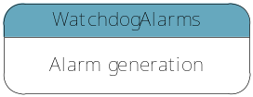


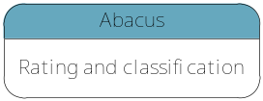
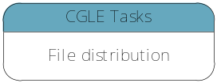
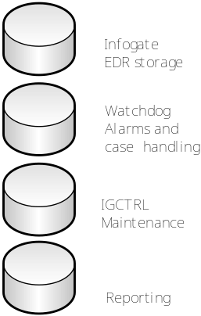



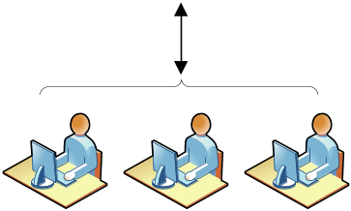
FLUJO DE DATOS EN SISTEMA

Slide 45
Agenda
Rating Rules - Abacus

Slide 46
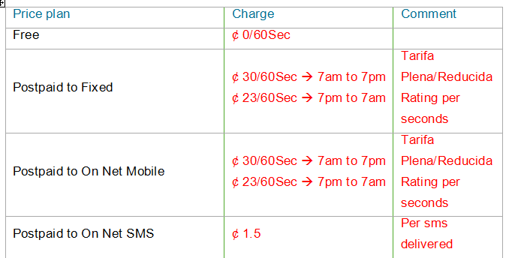
Local - Rating Rules

Slide 47
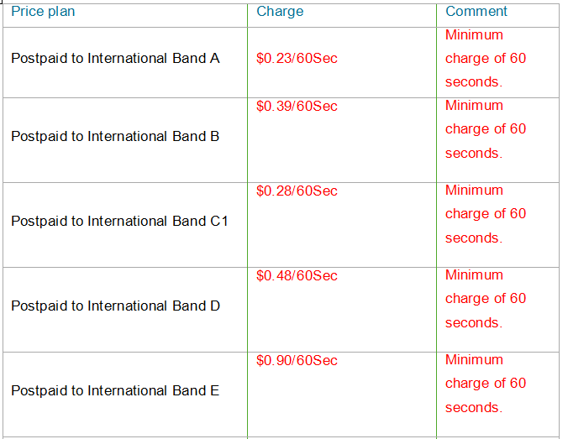
International - Rating Rules

Slide 48
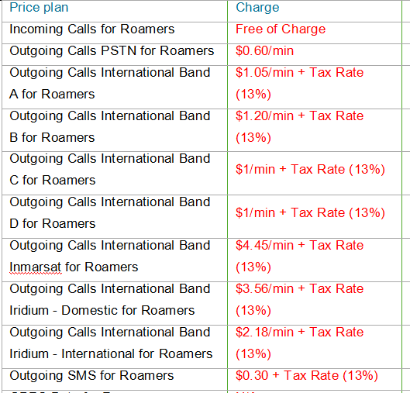
Roaming IN - Rating Rules

Slide 49
Agenda
GUI

Slide 50
Agenda
Rutinas de mantenimiento

Slide 51
Rutinas de mantenimiento
Task | Daily | Weekly | Monthly | Yearly
Update Exchange rates, Cell site list, Roaming partners, Update Exchange SDR |  | x
Update Holidays |  |  |  | x
Check the report data logs (Decoder, Abacus, Decoder32Copy and WatchDogAlarms) | x
Check Error and Unhandled Folder | x
Check daily database backup | x
Make a System Backup on tape |  | x
Check disk space |  | x
Check that applications are running | x
Make sure input data is forwarded to WatchDog | x
Delete Report Data Files in the Decoder32, Abacus, Decoder32Copy and WatchDogAlarms |  |  | x
Delete logfiles on servers C:\WINDOWS\system32\LogFiles |  |  | x

Slide 52
Conclusion – Questions & Answers
Questions ?

Slide 53


